Slide 1
Angular 7 features, Animation
Sowmya M
ID:5067544

Slide 2
Angular 7
Angular is a framework to build a web application, which is becoming popular because of its unique features and ease to build an application. Angular 7 is an open source framework developed by Google. It completely relies on HTML and JavaScript. It converts a static HTML page into dynamic HTML page.

Slide 3
Prerequisites of Angular7
Angular 2
Type Script
HTML
CSS

Slide 4
ANGULAR 7
FEATURES

Slide 5
Angular Features:
CLI prompt
Enhanced Application Performance
Angular Compatibility compiler
Angular material and component dev kit(CDK):
Virtual scrolling
Drag and drop

Slide 6
CLI Prompt
With v7.0.2, the users will be able to save time with prompts for built in features such as routing or SCSS support when running commands like ng-new, or ng-add

Slide 7
Angular compatibility compiler:
It is among the core Angular 7 benefits over Angular 6. The new release gets ngcc Angular node_module compatibility compiler. It converts node_modules complied using Angular Compatibility Compiler into node_modules that have appeared and compiled with TSC compiler transformer (ngtsc). Further, compiler conversions enable legacy packages leveraged by the Ivy rendering engine.

Slide 8
Angular material and component dev kit (CDK):
Angular 7 offers visual improvements from the updated Material Design specification. Other enhancements in CDK and Angular Material include extensive lists of data, virtual scrolling, dynamic loading and unloading of parts of the DOM, and more.

Slide 9
a. Virtual scrolling:
Benefits of angular include loading and unloading of items from the DOM, based on the visible parts of lists. It offers a faster user interface while scrolling through the long lists.
Introducing virtual scrolling
The Angular CDK provides Scrolling Component. We’re now going to add it to our plain table in 4 simple steps.

Slide 10

1. Add the dependency

Slide 11
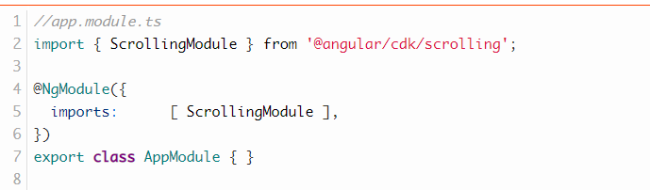
2. Add Scrolling Module:

Slide 12
3.Add Scrolling Component:
Step 2 is to add the <cdk-virtual-scroll-viewport> element around the markup of your table. We need to provide the attribute [itemSize]=”heightOfRowInPx” that tells the scrolling component how high each row is.

Slide 13
4. replace *ngFor with *cdkVirtualFor
instead of using *ngFor we’re going to use *cdkVirtualFor that is needed in order for the virtual scrolling to work as intended.

Slide 14
b. Drag and drop:
Angular new feature provides an improved way to build and drop interfaces. It further provides to sort within a list, support for animations, free dragging, and transferring items between lists, along with custom drag handles placeholders and previews.

Slide 15
Animation:
Animations add a lot of interaction between the html elements. Animation was available with Angular 2, from Angular 4 onwards animation is no more a part of the @angular/core library, but is a separate package that needs to be imported in app.module.ts.

Slide 16
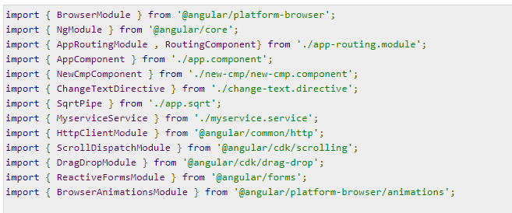
The BrowserAnimationsModule needs to be added to the import array in app.module.ts as shown below −

Slide 17
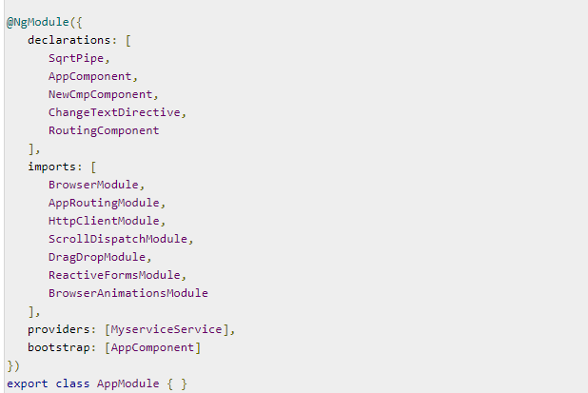

Slide 18
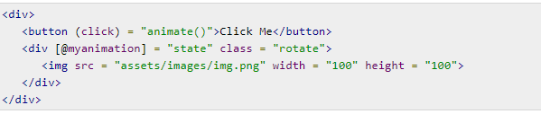
In app.component.html, we have added the html elements, which are to be animated.
Let us now see the app.component.ts where the animation is defined

Slide 19

Materials
Materials offer a lot of built-in modules for your project. Features such as autocomplete, datepicker, slider, menus, grids, and toolbar are available for use with materials in Angular 7.
To use materials, we need to import the package. Angular 2 also has all the above features but they are available as part of the @angular/core module. From Angular 4, Materials module has been made available with a separate module @angular/materials. This helps the user to import only the required materials in their project.
Following is the command to add materials to your project −

Slide 20
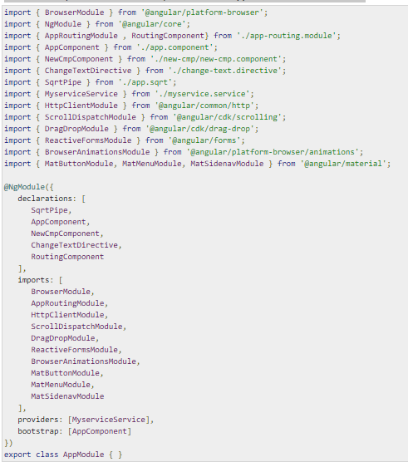
We will now import the modules in the parent module - app.module.ts as shown

Slide 21
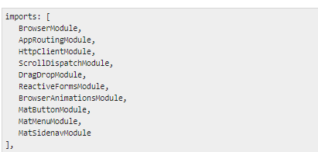
In the above file, we have imported the following modules from @angular/materials.
And the same is used in the imports array as shown below

